Slide 1
Chronic granulomatous conditions of nose

Slide 2
Rhinoscleroma

Slide 3
Rhinoscleroma is a chronic granulomatous condition of the nose and other structures of the upper respiratory tract.
It is a result of infection by the bacterium Klebsiella rhinoscleromatis.

Slide 4
Rhinoscleroma is contracted by means of the direct inhalation of droplets or contaminated material.
The disease probably begins in areas of epithelial transition such as the vestibule of the nose, the subglottic area of the larynx, or the area between the nasopharynx and oropharynx.

Slide 5
Rhinoscleroma usually affects the nasal cavity, but lesions associated with rhinoscleroma may also affect the larynx; nasopharynx; oral cavity; paranasal sinuses; or soft tissues of the lips, nose, trachea, and bronchi.

Slide 6
Epidemiology
It is endemic to regions of Africa (Egypt, tropical areas), Southeast Asia, Mexico, Central and South America, and Central and Eastern Europe.
Rhinoscleroma tends to affect females somewhat more often than it does males.
Typically, rhinoscleroma appears in patients aged 10-30 years.

Slide 7
Disease may start as a single nodule or in groups in nasal cavity.
The lesions do not suppurate or ulcerate
They heal by dense cicatrization, almost cartilage like hardness

Slide 8
Possible history findings
Nasal obstruction (most common complaint)
Rhinorrhea
Epistaxis
Dysphagia
Nasal deformity
Anesthesia of the soft palate
Difficulty breathing that progresses to stridor
Dysphonia
Anosmia

Slide 9
Pathological development
Diffuse stage resembling atrophic rhinitis
Stage of localisation and organisation
Stage of cicatrization

Slide 10
DD
Atrophic rhinitis
Tertiary syphilis
Lupus
Leprosy
Cancer

Slide 11
Treatment
Streptomycin
Tetracyclines
Chlorophenicol
Steroids
  Locally
  Systemically

Slide 12
Wegner’s Granulomatosis

Slide 13
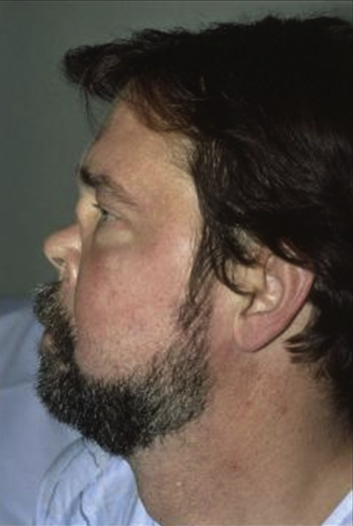
A condition characterized by granulomatous inflammation involving the respiratory tract and necrotizing vasculitis affecting small to medium sized vessels.
The pathological hallmark is the co-existence of vasculitis and granulomas and classically involves a triad of airway, lungs and renal disease.

Slide 14
Age and Sex
Significant number of patients below 25 years of age.
Younger patients present with a generalized form.

Slide 15
Aetiology
Aetiology remains unknown.
Its inflammatory nature and resemblance to polyarteritis nodosa suggests that it represents some form of hypersensitivity reaction.
It might be related to inhaled bacteria.

Slide 16
Clinical Features
Most patients start with minor ENT symptoms
  Variable degree of epistaxis
  Nasal Obstruction
  Bloody crusts
Destruction of intranasal structures including septum may follow leading eventually to nasal collapse.
Patients may complain of significant facial pain.

Slide 17
Clinical Features
Patients frequently complain of progressive malaise, pyrexia, weight loss and feel very unwell.
Nose and paranasal sinuses are involved in 80% patients.
Intranasal destruction of cartilage and bone leads to septal perforation.

Slide 18
Pulmonary symptoms
Cough
Haemoptysis
Pleuritic pain
Cavitation
Encapsulated lung abscess

Slide 19
Renal Symptoms
Between 30% to 90% patients develop renal symptoms.
Microscopic haematuria
Segmental or diffuse glomerulonephritis.

Slide 20
Ocular manifestations
Conjuctiviitis
Dacrocystitis
Corneal ulceration
Optic neuritis and retinal artery occlusion.
Blindness unilateral or bilateral

Slide 21
Otologic sympoms
Acute otitis media
Otitis media with effusion
Deafness
Otalgia
Both conductive and sensorineural hearing loss

Slide 22
Diagnosis
cANCA test is positive in 95% of patients.
A full blood count
ESR
Renal Profile
Urine analysis

Slide 23
Biopsy from septum or turbinates
Vasculitis
Granulomas of epithelial cell type
Multinucleated giant cells

Slide 24
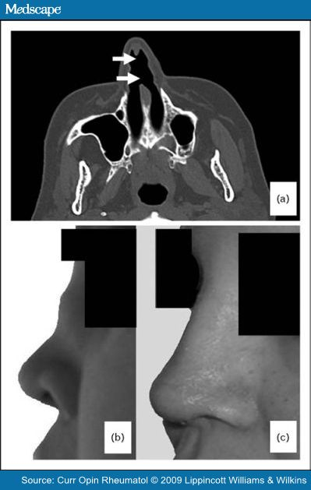
Mucosal thickening
Bone destruction
New bone formation

Slide 25
Treatment
Steroids and a variety of cytotoxic drugs improve short term prognosis by 90%.
Nasal symptoms managed by topical preparations.
Augmentation rhinoplasty

Slide 26
Septal Perforation

Slide 27
Causes
Trauma
  Surgical
  Repeated cautery
  Digital trauma
Malignant disease
  Malignant tumours
  Malignant granuloma
Chronic infections
  Syphilis
  Tuberculosis
  Leprosy

Slide 28
Poisons
  Industrial
  Cocaine addicts
Idiopathic
  Most are iatrogenic in origin
  Repeated cautery of the septum
  Occupational: Commonest cause is penetration of the nasal mucosa by one of the hexavalent forms of chromium.
  Other causes include exposure to soda ash, arsenic and its compounds, organic compounds of mercury, cocaine and snuff.

Slide 29
There are often four well marked stages of development:
  Redness and congestion of mucosa
  Blenching and anaemia
  Necrosis and development of crusts
  Final extension of crusts in to cartilage and perforation

Slide 30
Symptoms
Most septal perforations are asymptomatic.
Development of large crusts may cause nasal obstruction
Separation of crusts may lead to bleeding
Whistling noise
The larger the perforation more symptoms it would produce

Slide 31
Treatment
Cure the causative disease process
Perforations never heal spontaneously
Less severe cases can be satisfactorily controlled by nasal douching
Silastic Obturators can be used to close large perforations up to 4 cm in diameter.
If obturators fail to deliver consider surgery
Perforations larger than 2 cm are difficult to close

